Slide 1
Group Project B The discipline "Digital platforms" “The Game of TV-Tennis”
Completed:
Alekhin Nikita
(1st year, group 21216)
Muraviev Dmitry
(1st year, group 21216)

Slide 2
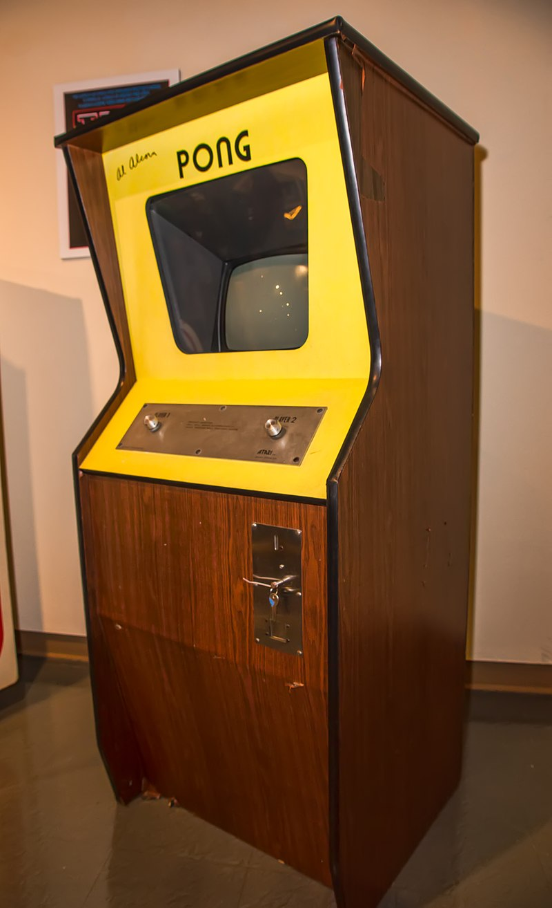
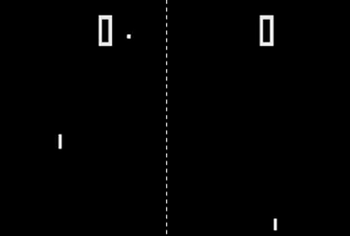
Pong in 1972
Gameplay
Arcade machine with Pong

Slide 3
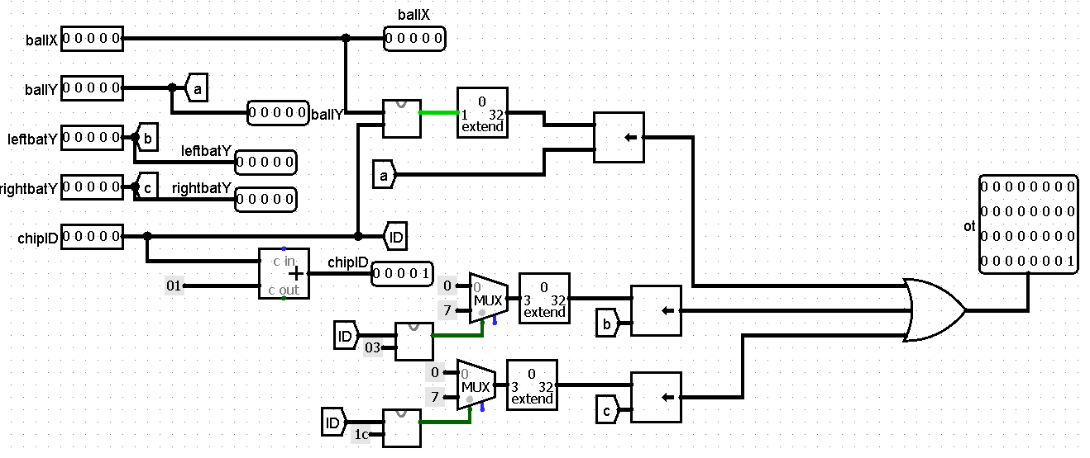
Video subsystem
Video chip

Slide 4
Kinematic controller
has to
Manage location of rackets
Make the movement right racket smoother
Scoring
Control the movement of the ball

Slide 5
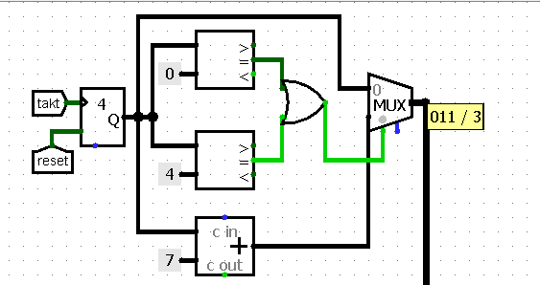
“unpredictable start”

Slide 6
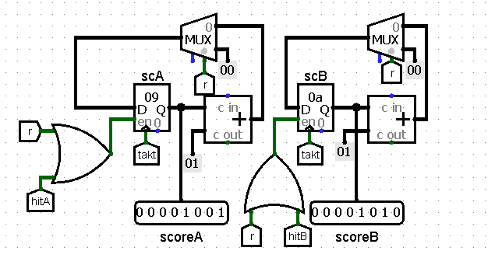
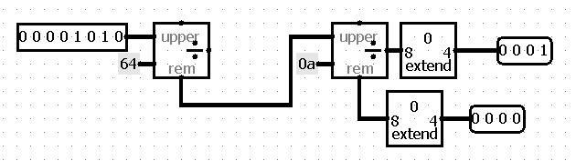
Score

Slide 7
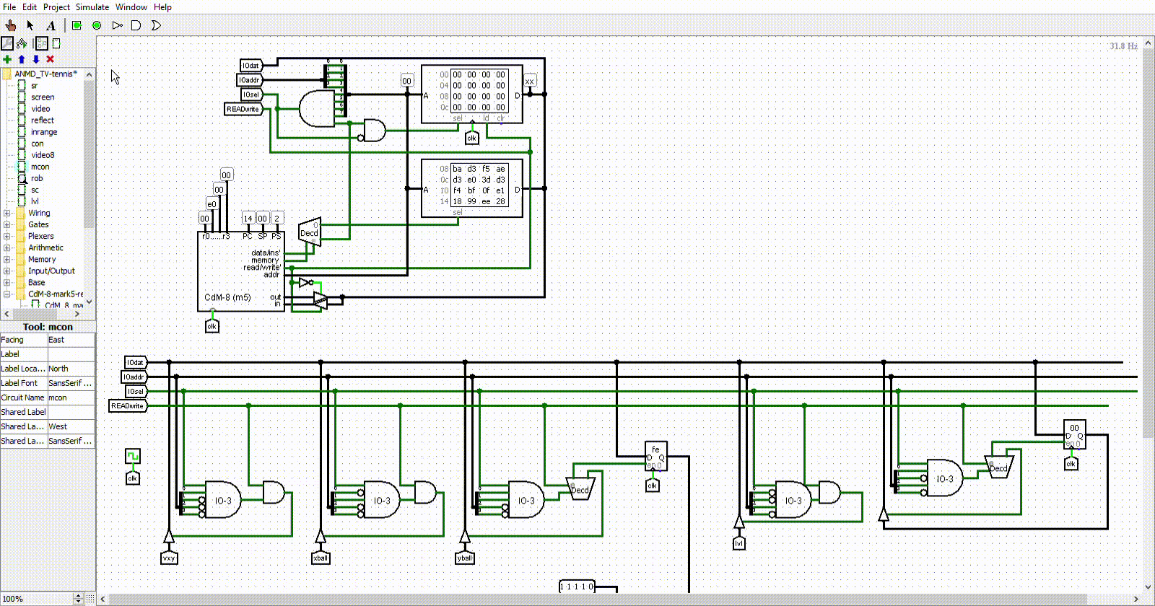
CDm-8

Slide 8
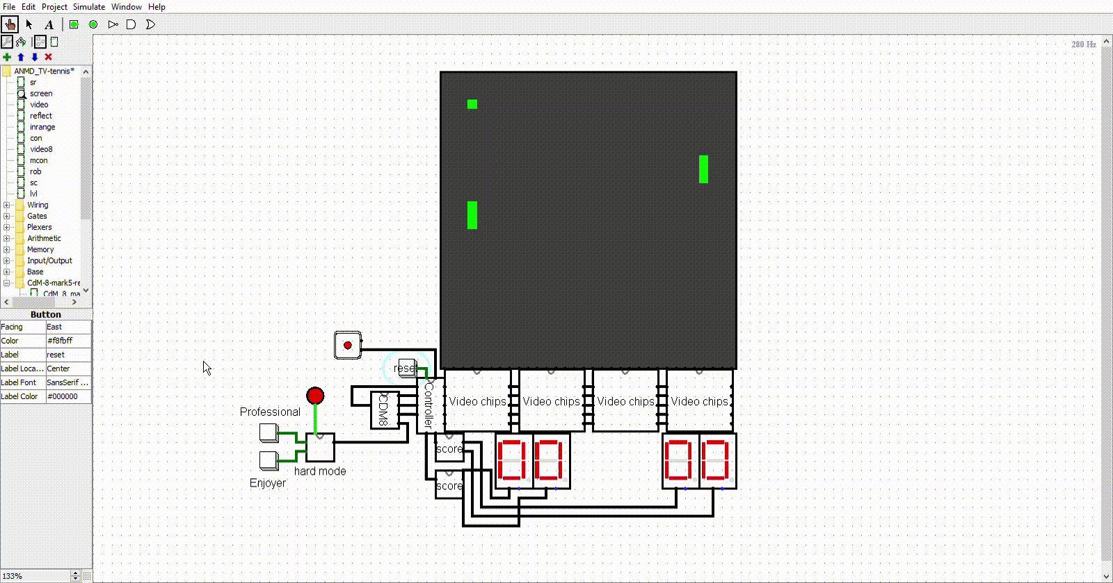
Result

Slide 9
Thank you for your attention!

